Slide 1
MY SQL
Project by :
Magesh M

Slide 2
CONTEXT
SQL Basics
2 . SQL Servers
3 . DBMS SYSTEM
4 . Database
5 . Data types
6 . BASIC COMMANDS IN SQL
7. MYSQL COMMANDES REGARDING DATABASE

Slide 3
8 . COMMANDS REGARDING TABLE MANIPULATION
9 . MY SQL Calculate Functions
10 . My SQL String Functions
11 . My SQL Date Functions
12 . MYSQL Constraints
13 . My SQL General Functions
14 . Logical Functions
15 . RDBMS System
16 . MySQL Joins
17 . RDBMS with subqueries
18 . Case and end

Slide 4
19 . having clause
20 . basic joins Trigger
21 . Procedures concepts (SQL Automation)
22 . Triggers (SQL Automation)

Slide 6
MY SQL - Introduction
SQL (Structured Query Language) is a programming language used to manage and manipulate relational database.
It allows users to create, modify, and query databases that are organized in a structured way, where data is stored in tables with defined relationships between them.
SQL can perform a wide range of operations including selecting, inserting, updating, and deleting data from a database
It is considered a standard language for interacting with relational databases and is supported by most database management systems.

Slide 7

SQL SERVER
SQL LITE
ORACLE
ACCESS
POSTGRE SQL
SQL SERVER

Slide 8

DATABASE
What is database ?
A database is an organized collection of structured information, or data, typically stored electronically in a computer system. A database is usually controlled by a database management system (DBMS). Together, the data and the DBMS, along with the applications that are associated with them, are referred to as a database system, often shortened to just database.

Slide 9
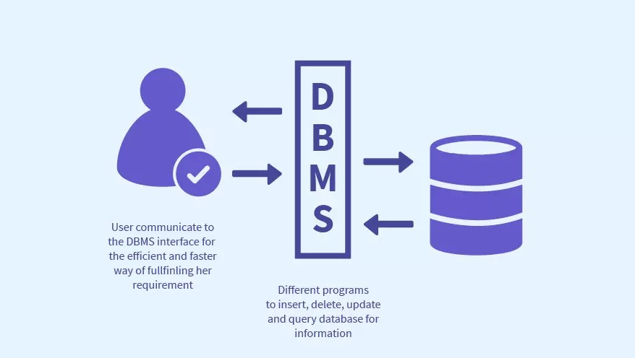
DBMS – Data Base Management System
What is DBMS ?
Database Management System is a software or technology used to manage data from a database. Some popular databases are MySQL, Oracle, MongoDB, etc. DBMS provides many operations e.g. creating a database, Storing in the database, updating an existing database, delete from the database. DBMS is a system that enables you to store, modify and retrieve data in an organized way. It also provides security to the database.

Slide 10
DATA TYPES
NUMERIC DATA TYPE
Numeric Data Type | Description
INT | -2147483648 to 2147483647 0 to 4294967295. 11 digits.
TINYINT | -128 to 127 0 to 255 4 digits
SMALLINT | -32768 t0 32767 0 to 65535 5 digits
MEDIUMINT | -8388608 to 8388607 0 to 16777215 9 digits

Slide 11
Numeric Data Type | Description
BIGINT | -9223372036854775808 to 9223372036854775808 0 to 18446744073709551615 20 digits.
FLOAT(m,d) | Default to 10,2 24 places for a float.
DOUBLE(m,d) | Default to16,4, 53 places for double.

Slide 12
DATE & TIME DATE TYPE
DataType | Range | Example
Date | ‘1000-01-01’ to ‘9999-12-31’. | Displayed as ‘yyyy-mm-dd’.
Date Time | ‘1000-01-01 00:00:00’ to ‘9999-12-31 23:59:59’. | Displayed as ‘yyyy-mm-dd hh:MM:SS’.
Timestamp Timestamp Diff | ‘1970-01-01 00:00:01’ UTC to ‘2038-01-19 03:14:07’ TC. | Displayed as ‘yyyy-mm-dd hh:MM:SS’.
Time | ‘-838:59:59’ to ‘838:59:59’. | Displayed as ‘HH:MM:SS’
Year | 2 digits or 4 digits. | Default is 4 digits.

Slide 13
STRING DATATYPE
Data Type | Range
VARCHAR (Size) | Maximum size of 255 characters.
TINYTEXT(Size) | Maximum size of 255 characters.
TEXT(Size) | Maximum size of 65,535 characters. 5 digits
MEDIUMTEXT (Size) | Maximum size of 16,777,215 characters. 9 digits
LONGTEXT (Size) | Maximum size of 4GB or 4,294,967,295 characters.
BINARY (Size) | Maximum size of 255 Characters
VARBINARY (Size) | Maximum size of 255 Characters

Slide 14
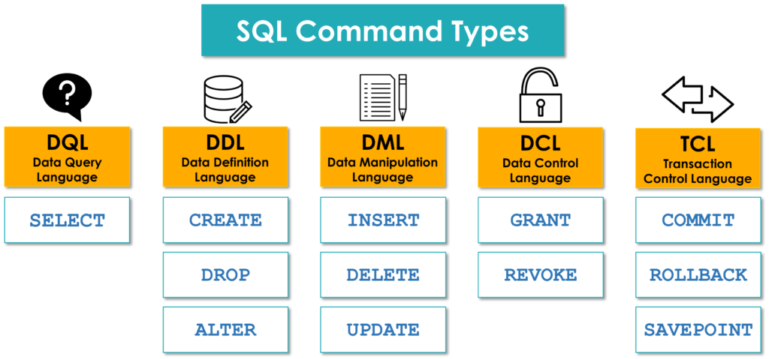
BASIC COMMANDS IN SQL

Slide 15
MYSQL COMMANDES REGARDING DATABASE
Create database (Create a New Database)
Show Database (View Databases)
Drop Database

Slide 16
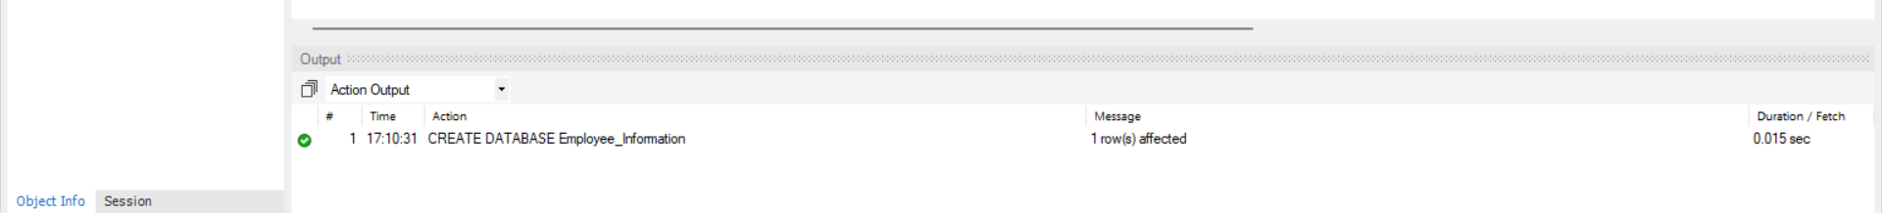
CREATION OF DATABASE
This command is used to create a new database
Syntax : CREATE DATABASE databasename;
SQL query to create database
CREATE DATABASE Employee_Information;

Slide 17
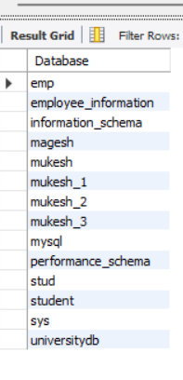
SHOW DATABADSE COMMAND
This command is used to show the names of database you have created and inbuilt.
The SQL query to Show database
SHOW DATABASE ;

Slide 18
DROP DATABAES COMMAND
This statement is used to drop an existing database. This leads to complete loos of data in database
Syntax : DROP DATABASE databasename;
The SQL query to drop database
DROP DATABASE Employee_Information;

Slide 19
MYSQL Constraints
Constraints can be specified when the table is created with the CREATE TABLE
statement, or after the table is created with the ALTER TABLE statement.
Syntax : CREATE TABLE table_name (
column1 datatype constraint,
column2 datatype constraint,
column3 datatype constraint,
....
);
SQL constraints are used to specify rules for the data in a table.
PRIMARY KEY
FOREIGN KEY
DEFAUL
NOT NULL

Slide 20
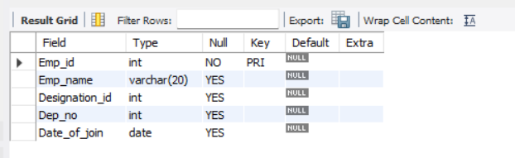
PRIMARY KEY
The PRIMARY KEY constraint uniquely identifies each record in a table.
Primary keys must contain UNIQUE values, and cannot contain NULL values.
CREATE TABLE Emp_details ( Emp_id INT,
Emp_name VARCHAR(20),
Designation_id INT,
Dep_no INT,
Date_of_join DATE,
PRIMARY KEY (Emp_id));

Slide 21
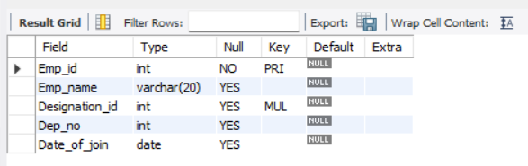
2. FOREIGN KEY
A FOREIGN KEY is a field (or collection of fields) in one table, that refers to the
PRIMARY KEY in another table.It show the relationship between the tables.
CREATE TABLE Designations ( Designation_id INT PRIMARY KEY,
Designation_name VARCHAR(50));
CREATE TABLE Emp_details ( Emp_id INT,
Emp_name VARCHAR(20),
Designation_id INT,
Dep_no INT,
Date_of_join DATE,
PRIMARY KEY (Emp_id),
FOREIGN KEY (Designation_id) REFERENCES Designations(Designation_id));

Slide 22
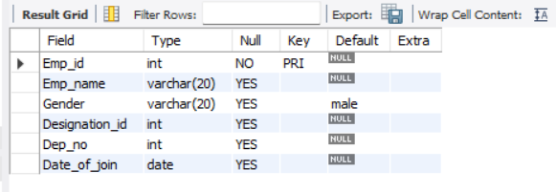
3. DEFAUL
The DEFAULT constraint is used to set a default value for a column.
The default value will be added to all new records, if no other value is specified.
CREATE TABLE Emp_details ( Emp_id INT,
Emp_name VARCHAR(20),
Gender varchar(20) default 'male’,
Designation_id INT,
Dep_no INT,
Date_of_join DATE,
PRIMARY KEY (Emp_id)
);

Slide 23
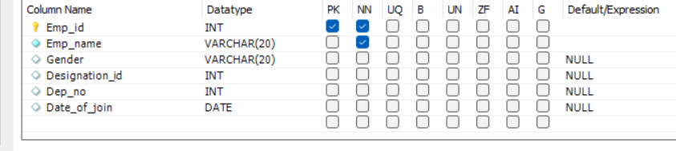
4. NOT NULL
The DEFAULT constraint is used to set a default value for a column.
The default value will be added to all new records, if no other value is specified.
CREATE TABLE Emp_details ( Emp_id INT,
Emp_name VARCHAR(20) not null,
Gender varchar(20) ,
Designation_id INT,
Dep_no INT,
Date_of_join DATE,
PRIMARY KEY (Emp_id));

Slide 24
COMMANDS REGARDING TABLE MANIPULATION
Create Tables
Show tables
Insert Values
Drop Table
Alter table ( For New Column Creation)
Alter Table Modify
Alter table Drop ( Drop the Column)
Alter table Rename (Rename the Table)
Update Table ( To change the Values)

Slide 25
TABLE CREATION COMMAND
This table is to create a table top an existing table.
Syntax : CREATE TABLE table_name ( column1 datatype, column2 datatype, column3 datatype);
The SQL query to create table
CREATE TABLE Emp_details
( Emp_id INT,
Emp_name VARCHAR(20),
Designation_id INT,
Dep_no INT,
Date_of_join DATE,
PRIMARY KEY (Emp_id));

Slide 26
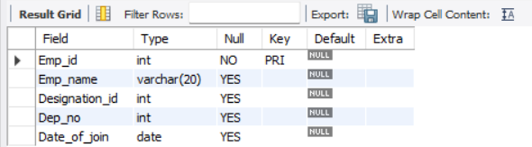
DESCRIBE TABLE COMMAND
This command is used to describe the table’s information like primary key , foreign key , etc…
The SQL query to describe table
DESCRIBE Emp_detials;

Slide 27
INSERT COMMAND
This command is used to insert values to the table which we created
The SQL query to insert value to a table
INSERT INTO emp_detials VALUES
(values);

Slide 28
DROP TABLE COMMAND
This command is used to drop a table created which already existed in database .
Syntax : DROP TABLE table_name;
The SQL query to drop a table
drop table Emp_detials;

Slide 29
ALTERING TABLE COMMANDS
The ALTER TABLE statement is used to add, delete, or modify columns in an existing table.
The ALTER TABLE statement is also used to add and drop various constraints on an existing table.

Slide 30
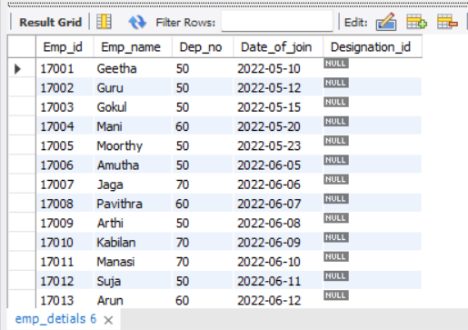
ALTER TABLE – ADDING NEW COLUMN
This command is used to add a column to an existing table
The SQL query to add column using alter command
ALTER TABLE emp_detials ADD Designation_id int;

Slide 31
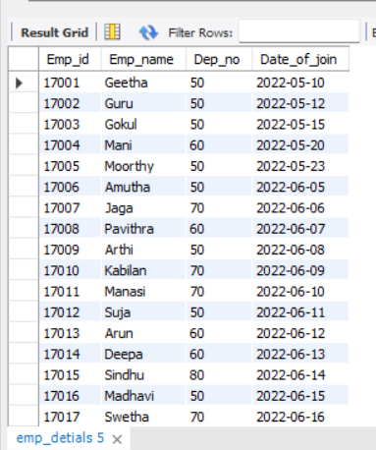
ALTER COLUMN – DROP A EXISTING COMMAND
This command is used to drop(delete) a column in existing table
The SQL query to drop a column
ALTER TABLE emp_detials DROP Designation_id;

Slide 32
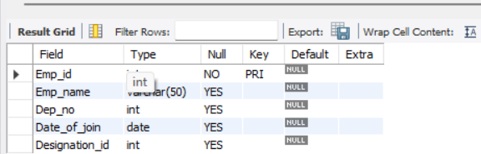
ALTER TABLE USING – MODIFY COMMAND
To change the data type of a column in a table .
The SQL query to modify datatype
ALTER TABLE emp_detials MODIFY Emp_name varchar(50);

Slide 33
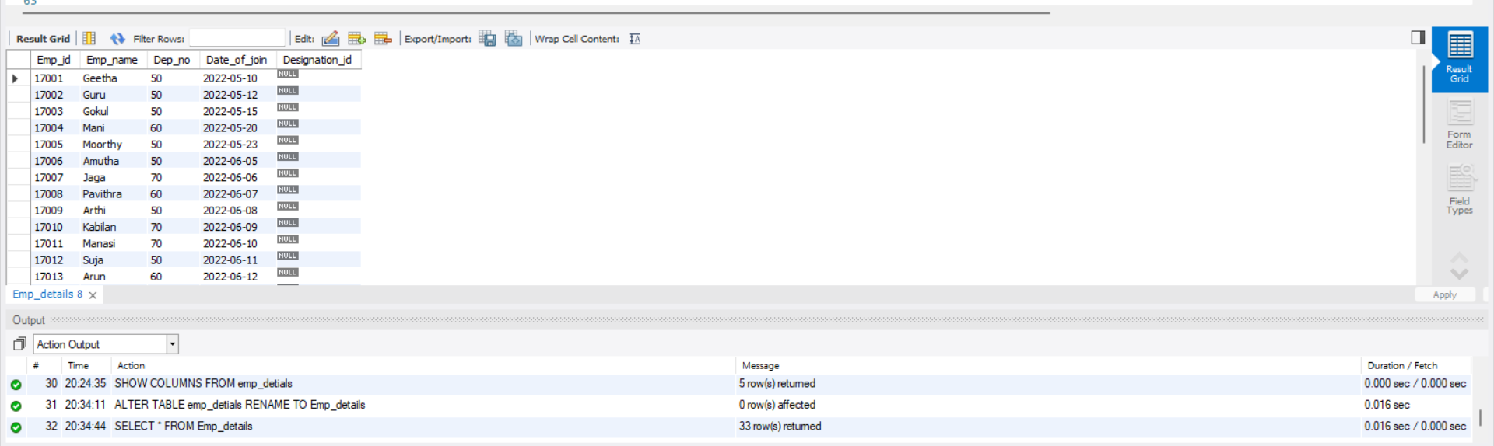
ALTER TABLE – RENAMEING A TABLE
This command is used to rename an existing table name
The SQL query to rename a table
ALTER TABLE emp_detials RENAME TO Emp_details;
SELECT * FROM Emp_details;

Slide 34
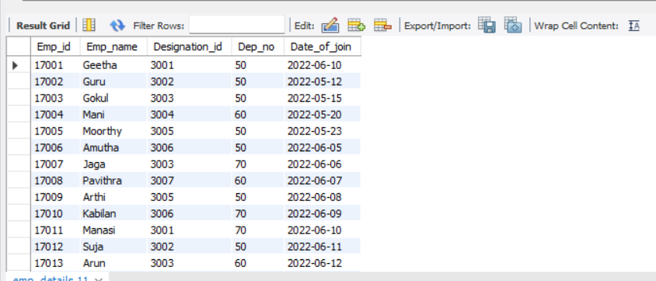
ALTER TABLE – UPDATING VALUE
This command is used to update the existing values in table
The SQL query to update a values in table
UPDATE Emp_details SET Date_of_join = '2022-6-10' where emp_id = 17001;

Slide 35
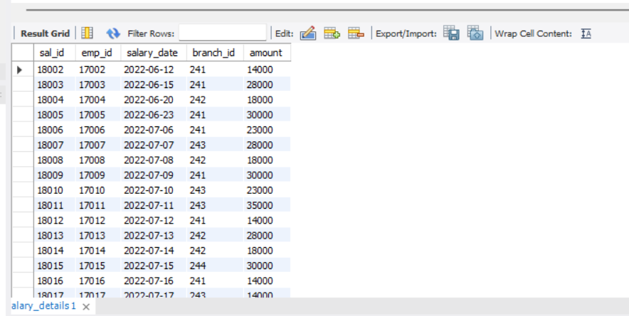
DELETE STATEMENT
This command is used to delete an individual records from table
The SQL query for delete statement
DELETE FROM salary_details WHERE emp_id = 17001;

Slide 36
MY SQL Calculate Functions
Sum
Average
Min
Max
Count

Slide 37
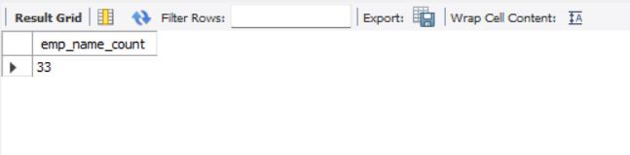
Count function
This function is used find the count of instances in a row
The SQL query for count function
SELECT COUNT(emp_name) AS emp_name_count FROM emp_details;

Slide 38
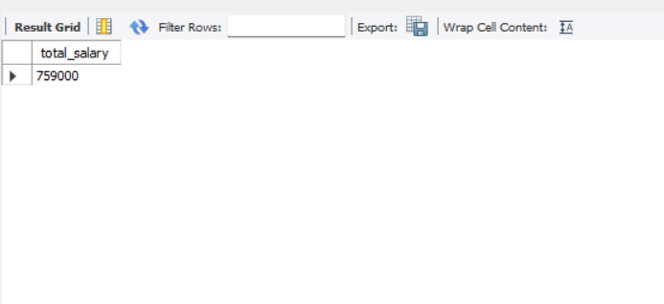
SUM FUNCTION
The sum function is used find the total amount of a row
The SQL query to find sum of the row
SELECT sum(amount) AS total_salary FROM salary_details;

Slide 39
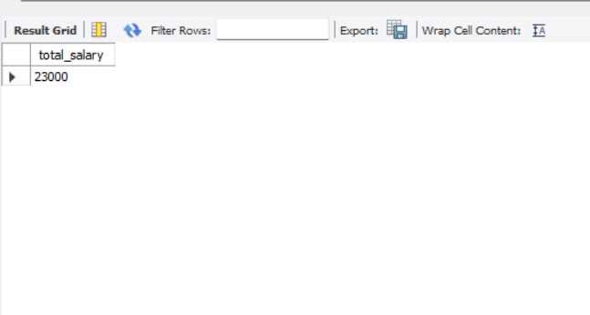
AVERAGE FUNCTON
This function is used to find the average value of selected row or column
The SQL query to find average
SELECT ROUND(avg(amount),0) AS total_salary FROM salary_details;

Slide 40
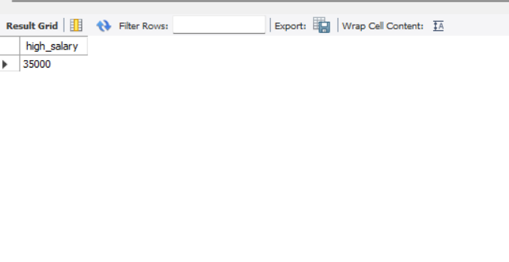
MAXMIMUM FUNCTION
This function is used find maximum value
The SQL query to find maximum value
SELECT max(amount) AS high_salary FROM salary_details;

Slide 41
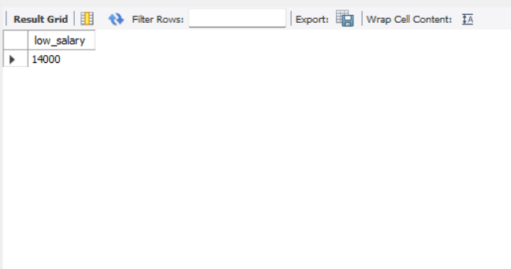
MINIMUM FUNCTION
This function is used find minimun value in selected column
The SQL query to find maximum value
SELECT min(amount) AS low_salary FROM salary_details;

Slide 42
My SQL String Functions
LCase
UCase
Left
Right
Concat
Trim
Char_Length
Mid
Length

Slide 43
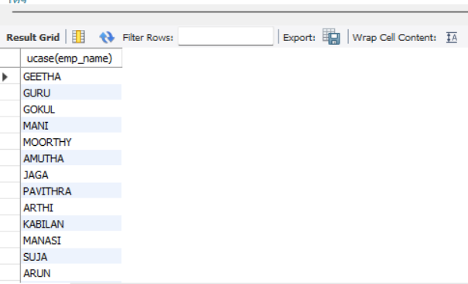
UCASE
This is used to convert the word into upper case
The SQL query to change into upper case
SELECT ucase(emp_name) FROM emp_details;

Slide 44
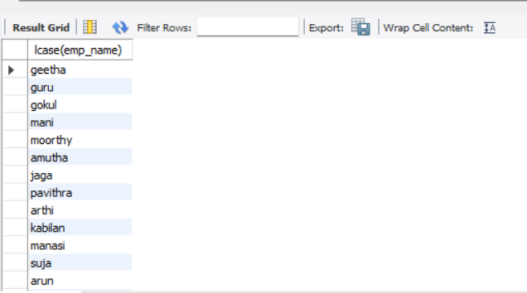
LCASE
This is used to convert the word into lower case
The SQL query to change into upper case
SELECT lcase(emp_name) FROM emp_details;

Slide 45
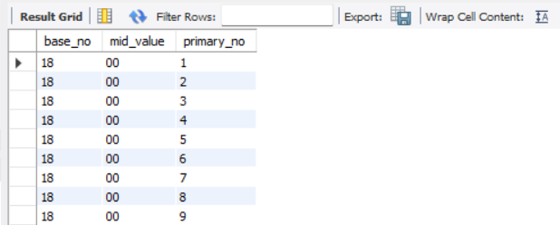
LEFT, RIGHT, MID - SPLIT
This string function is used to split the values
The SQL query for split function
SELECT LEFT (salary_id,2) AS base_no,
MID(salary_id,3,2)AS mid_value,
RIGHT(salary_id,1) AS primary_no
FROM salary_details;

Slide 46
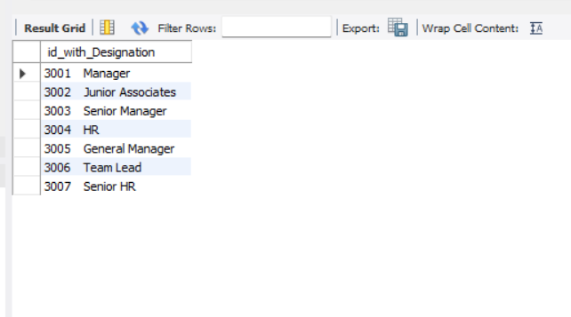
CONCAT
This function is used to concat values of two column
The SQL query to concat
SELECT concat(Designation_id," ", Designation) AS id_with_Designation FROM designation_in_company;

Slide 47
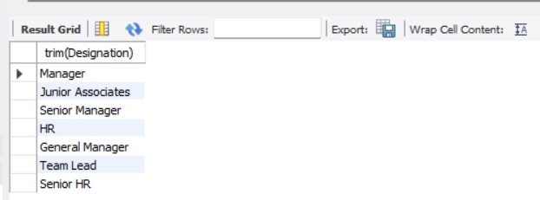
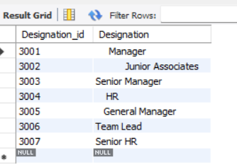
TRIM
This function is used to trim space between front and back of a given data
The SQL command for string function
SELECT trim(Designation) FROM designation_in_company;
AFTER
BEFORE

Slide 48
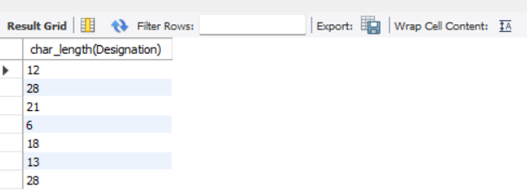
CHAR _LENGTH
This is used to find the length of character
The SQL query for char_length
SELECT char_length(Designation) FROM designation_in_company;

Slide 49
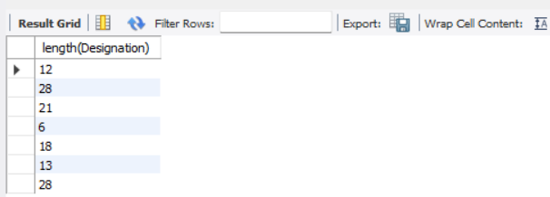
LENGTH
This is used to find the length of character
The SQL query for length
SELECT length(Designation) FROM designation_in_company;

Slide 50
My SQL Date Functions
Date ADD
Datediff
Timestamp DIff
Date Format
Year
Day
Month
Now

Slide 51
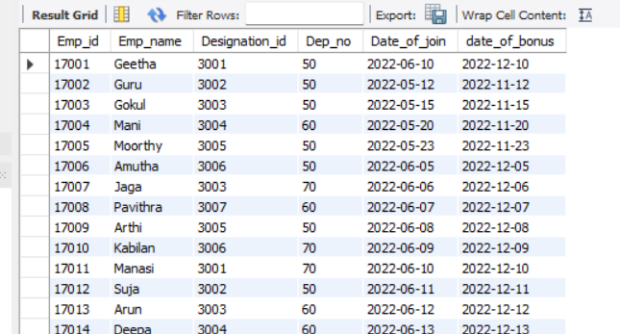
Date ADD
This function is used to calculate date after certain interval
The SQL query for add date
select *, adddate(date_of_join, interval 6 month) as date_of_bonus from emp_details;

Slide 52
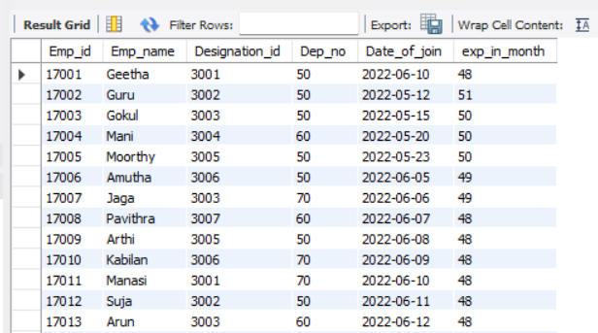
Datediff
This function is used to find date difference from selected date or current date
The SQL query for datediff function
select *, round(datediff(curdate(),date_of_join)/12 ,0) as exp_in_month from emp_details;

Slide 53
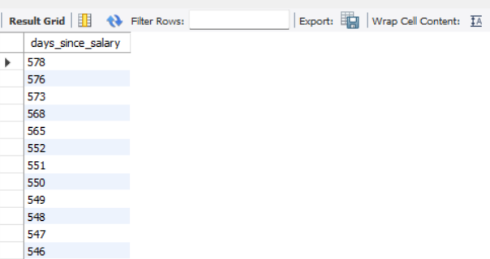
Timestamp DIff
the TIMESTAMPDIFF function in SQL calculates the difference between two timestamps in terms of a specific time unit, like days, months, hours, etc
The SQL query for timestampdiff
SELECT TIMESTAMPDIFF(DAY, salary_date, CURDATE()) AS days_since_salary FROM salary_details;

Slide 54
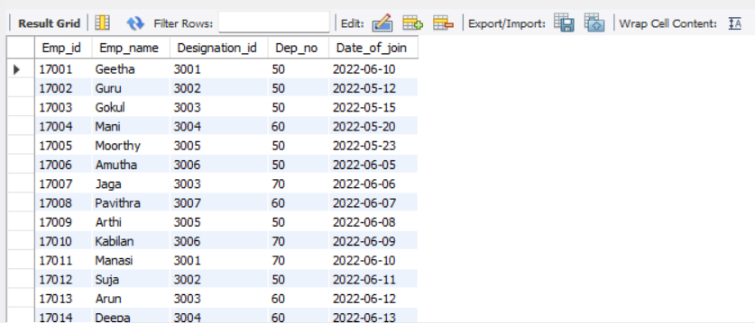
YEAR
To extract the year, from a date or timestamp, you can use this function
The SQL query using year
select * from emp_details where year(date_of_join) = 2022;

Slide 55
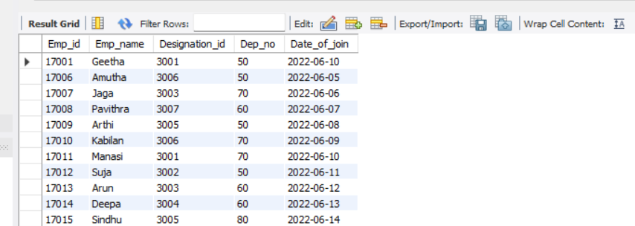
MONTH
To extract the year, from a date or timestamp, you can use this function
The SQL query using year
select * from emp_details where MONTH(date_of_join) = 6;

Slide 56
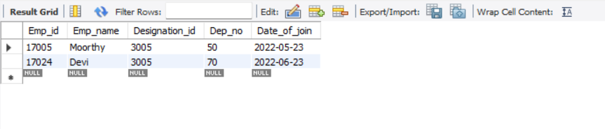
DAY
To extract the year, from a date or timestamp, you can use this function
The SQL query using year
select * from emp_details where DAY(date_of_join) = 23;

Slide 57
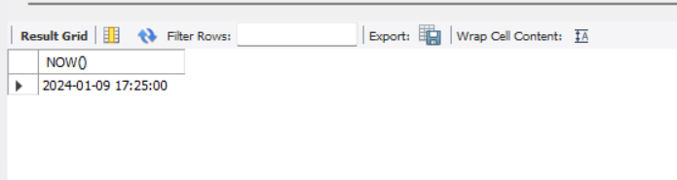
NOW
The NOW() function returns the current date and time.
The SQL query for now() function
SELECT NOW();

Slide 58
My SQL General Functions
Where
or
and
in
Not in
>
<
>=
<=
<> (Not in)
!
Distinct
Count With Distinct
Order by Asc
Order By Desc
Group By
Limit
Desc Limit
Like (_%)
Not like
Between

Slide 59
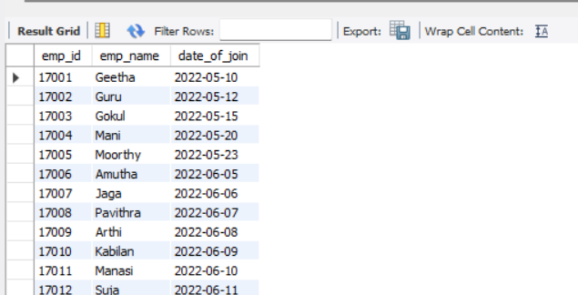
SELECT Statement
The SELECT statement is used to select data from a database.
The data returned is stored in a result table, called the result-set.
Syntax : SELECT column1, column2, ...
FROM table_name;
The SQL query for select statement
select emp_id, emp_name, date_of_join from emp_details;

Slide 60
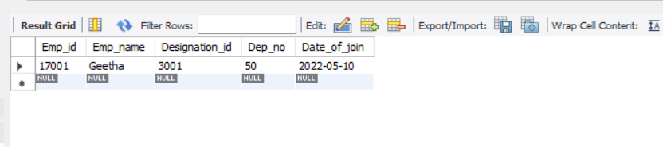
WHERE Clause
The WHERE clause is used to filter records.
syntax : SELECT column1, column2, ...
FROM table_name
WHERE condition;
The SQL query for where clause
select * from emp_details where emp_id = 17001;

Slide 61
AND, OR Operators
The AND and OR operators are used to filter records based on more than one condition:
The AND operator displays a record if all the conditions separated by AND are TRUE.
The OR operator displays a record if any of the conditions separated by OR is TRUE.
Syntax :
SELECT column1, column2, ...
FROM table_name
WHERE condition1 AND condition2 AND condition3 ...;
SELECT column1, column2, ...
FROM table_name
WHERE condition1 OR condition2 OR condition3 ...;

Slide 62
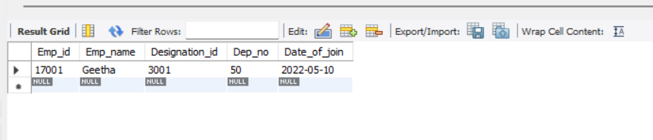
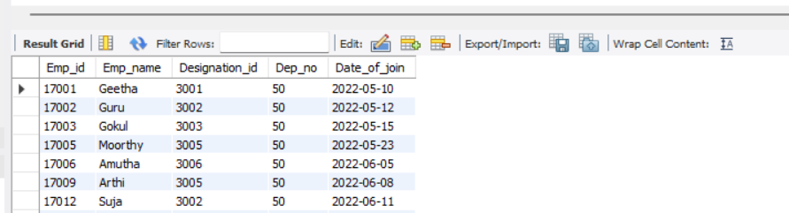
And
SELECT * FROM emp_details WHERE emp_id = 17001 AND Dep_no = 50;
OR
SELECT * FROM emp_details WHERE emp_id = 17003 or Dep_no = 50;

Slide 63
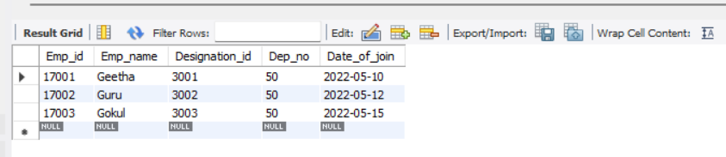
IN Operator
The IN operator allows you to specify multiple values in a WHERE clause.
Syntax : SELECT column_name(s)
FROM table_name
WHERE column_name IN (value1, value2, ...);
The sql query for in operator
SELECT * FROM emp_details WHERE emp_id in( 17001, 17002, 17003);

Slide 64
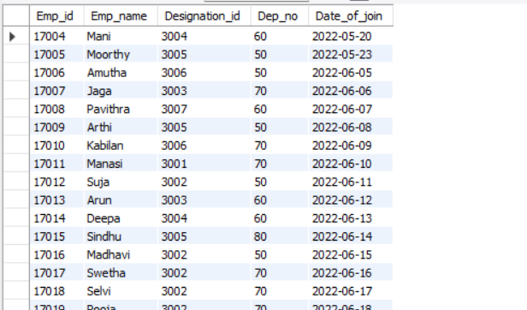
NOT IN Operator
Syntax : SELECT column_name(s)
FROM table_name
WHERE column_name NOT IN (value1, value2, ...);
The sql query for not in operator
SELECT * FROM emp_details WHERE emp_id not in( 17001, 17002, 17003);

Slide 65
COMPARISON OPERATORS
This function are used to compare the values
The SQL query for comparison operator
Greater than : select * from emp_details where dep_no > 60;
Less than : select * from emp_details where dep_no < 60;
Not equal to : select * from emp_details where dep_no <> 60;
select * from emp_details where dep_no != 60;
Greater than or equal to : select * from emp_details where dep_no >= 60;
Less than or equal to : select * from emp_details where dep_no <= 60;

Slide 66
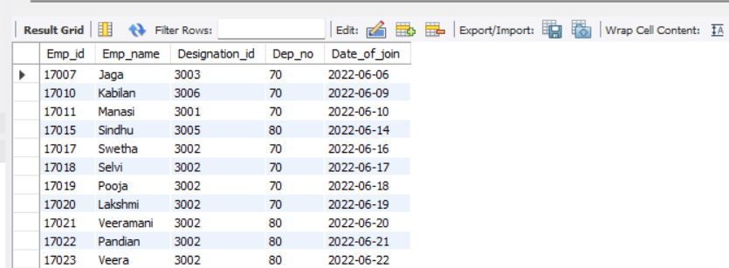
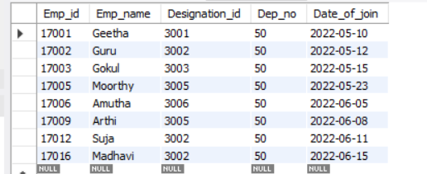
1.
2.

Slide 67
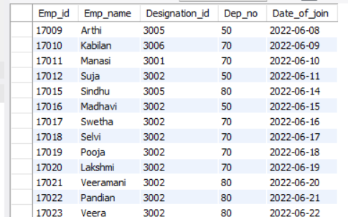
3.
4.

Slide 68
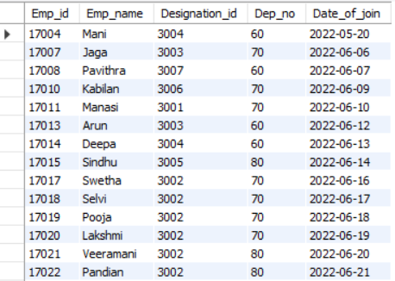
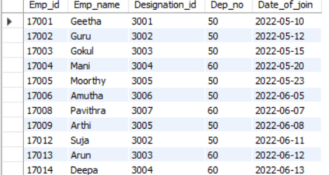
5.
6.

Slide 69
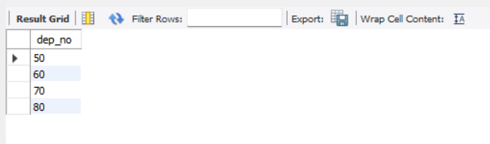
DISTINCT
This function is used to unique element in column
The SQL query for distinct function
select distinct(dep_no) from emp_details;

Slide 70
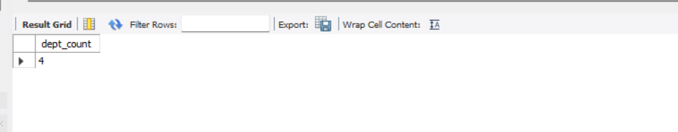
COUNT AND DISTINCT
This function is combination of both count and distinct function
The SQL query for Count With Distinct function
select count(distinct(dep_no)) as dept_count from emp_details ;

Slide 71
ORDER BY
The ORDER BY keyword is used to sort the result-set in ascending or descending order.
The ORDER BY keyword sorts the records in ascending order by default.
Syntax : SELECT column1, column2, ...
FROM table_name
ORDER BY column1, column2, ... ASC|DESC;

Slide 72
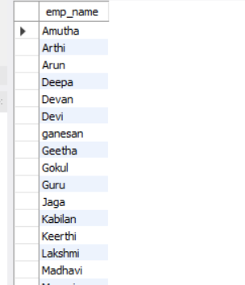
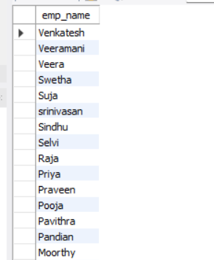
The SQL query for order by asc
select emp_name from emp_details
order by emp_name asc;
The SQL query for order by adesc
select emp_name from emp_details
order by emp_name desc;

Slide 73

GROUP BY
The GROUP BY statement groups rows that have the same values into summary rows
The GROUP BY statement is often used with aggregate functions (COUNT(), MAX(), MIN(), SUM(), AVG()) to group the result-set by one or more columns.
Syntax :
SELECT column_name(s)
FROM table_name
WHERE condition
GROUP BY column_name(s)
ORDER BY column_name(s);
The SQL query for group by function
select dep_no, count(emp_name) as emp_count from emp_details group by dep_no;

Slide 74

LIMIT Clause
The LIMIT clause is used to specify the number of records to return.
Syntax : SELECT column_name(s)
FROM table_name
WHERE condition
LIMIT number;
The SQL query for limit clause
select * from emp_details limit 0,5;

Slide 75

MySQL provides a way to handle this: by using OFFSET.
select * from emp_details limit 5 offset 5;

Slide 76
LIKE And NOT LIKE Operator
The LIKE operator is used in a WHERE clause to search for a specified pattern in a column.
There are two wildcards often used in conjunction with the LIKE operator:
The percent sign (%) represents zero, one, or multiple characters
The underscore sign (_) represents one, single character
Syntax :
SELECT column1, column2, ...
FROM table_name
WHERE columnN LIKE pattern;
1.The SQL query for Like function
select * from emp_details where emp_name like 'A%';
2.The SQL query for not like function
select * from emp_details where emp_name not like 'A%';

Slide 77


1.
2.

Slide 78

BETWEEN Operator
The BETWEEN operator selects values within a given range. The values can be numbers, text, or dates.
The BETWEEN operator is inclusive: begin and end values are included.
Syntax
SELECT column_name(s)
FROM table_name
WHERE column_name BETWEEN value1 AND value2;
The SQL query for between operator
select * from emp_details where date_of_join between '2022-04-02' and '2022-06-30';

Slide 79
Logical Functions
IF
If with and conditons
If with or conditions
Count If

Slide 80

IF() Function
The IF() function returns a value if a condition is TRUE, or another value if a condition is FALSE.
Syntax
IF(condition, value_if_true, value_if_false)
The SQL query for IF() function
select salary_id,emp_id, amount ,
if(amount >= 25000, "eligble_for_bonus", "not_eligible_bonous") from salary_details;

Slide 81

IF WITH COUNT FUNCTION
SELECT
COUNT(IF(amount >= 25000, 1, NULL)) AS eligible_count,
COUNT(IF(amount < 25000, 1, NULL)) AS not_eligible_count
FROM
salary_details;

Slide 82

IF WITH AND , OR CONDITION
SELECT
salary_id,
emp_id ,
COUNT(IF(amount >= 25000 AND emp_id IN (17005,17010,17007,17024,17013,17011), 1, NULL)) AS eligible_count,
COUNT(IF(amount < 25000 OR emp_id NOT IN (17005,17010,17007,17024,17013,17011), 1, NULL)) AS not_eligible_count
FROM
salary_details
GROUP BY
salary_id;

Slide 83
RDBMS System
A relational database defines database relationships in the form of tables. The tables are related to each other - based on data common to each.
Two table connection
Three table connection

Slide 84

Two table connection
select * from emp_details inner join salary_details on
emp_details.emp_id = salary_details.emp_id ;

Slide 85

Three table connection
select * from emp_details inner join salary_details on
emp_details.emp_id = salary_details.emp_id inner join departmet_det on
salary_details.branch_id = departmet_det.branch_id ;

Slide 86
MySQL Joins
A JOIN clause is used to combine rows from two or more tables, based on a related column between them.
INNER JOIN
LEFT JOIN
RIGHT JOIN
CROSS JOIN
UNION Operator

Slide 87

INNER JOIN
The INNER JOIN keyword selects records that have matching values in both tables.
Syntax
SELECT column_name(s) FROM table1 INNER JOIN table2 ON table1.column_name = table2.column_name;
MySQL INNER JOIN

Slide 88

select e.emp_id,e.emp_name, e.date_of_join,s.salary_id,s.amount
from emp_details e inner join salary_details s on
e.emp_id = s.emp_id;

Slide 89

LEFT JOIN
The LEFT JOIN keyword returns all records from the left table (table1), and the matching records (if any) from the right table (table2).
Syntax
SELECT column_name(s) FROM table1 LEFT JOIN table2 ON table1.column_name = table2.column_name;
MySQL LEFT JOIN

Slide 90

select * from emp_details e
left join salary_details s on
e.emp_id = s.emp_id;

Slide 91

RIGHT JOIN
The RIGHT JOIN keyword returns all records from the right table (table2), and the matching records (if any) from the left table (table1).
Syntax
SELECT column_name(s) FROM table1 RIGHT JOIN table2 ON table1.column_name = table2.column_name;
MySQL RIGHT JOIN

Slide 92

select * from emp_details e right join salary_details s on e.emp_id = s.emp_id;

Slide 93

CROSS JOIN
The CROSS JOIN keyword returns all records from both tables (table1 and table2).
Syntax
SELECT column_name(s) FROM table1 CROSS JOIN table2;
MySQL CROSS JOIN

Slide 94

select * from emp_details e cross join salary_details s on e.emp_id = s.emp_id;

Slide 95
UNION Operator
The UNION operator is used to combine the result-set of two or more SELECT statements.
Every SELECT statement within UNION must have the same number of columns
The columns must also have similar data types
The columns in every SELECT statement must also be in the same order
Syntax
SELECT column_name(s) FROM table1 UNION SELECT column_name(s) FROM table2;

Slide 96

SELECT e.emp_id, e.emp_name, s.amountFROM emp_details eLEFT JOIN salary_details s ON
e.emp_id = s.emp_id
UNION
SELECT e.emp_id, e.emp_name, s.amountFROM salary_details sLEFT JOIN emp_details e ON
e.emp_id = s.emp_id;

Slide 97

RDBMS with subqueries
Absolutely! Subqueries in an RDBMS (Relational Database Management System) are nested SQL queries placed within the WHERE or HAVING clause of another SQL query.
The SQL query for RDBMS with subqueries
select emp_id,emp_name,date_of_join from emp_details where emp_id in (select emp_id from salary_details);

Slide 98

CASE and END
In SQL, the CASE statement is a powerful tool used to perform conditional logic within a query. It allows you to evaluate conditions and return different values based on those conditions
select e.emp_id,e.emp_name,s.amount,
Case when s.amount >= 25000
then 'eligible for bonus’
else 'not eligible’
end as eligibility
from emp_details e inner join salary_details s on
e.emp_id = s.emp_id;

Slide 99

CASE END with AND function
SELECT emp_id, emp_name, dep_no,
CASE WHEN dep_no in( 50, 60, 70, 80) AND (date_of_join between '2022-6-01' and '2022-6-30’)
THEN 'joined at sixth month’
ELSE 'may be in some other month’
END AS category
FROM emp_details;

Slide 100

CASE END with OR function
SELECT emp_id, emp_name, dep_no,
CASE WHEN dep_no = 50 or dep_no = 60 then 'category A’
WHEN dep_no = 70 or dep_no = 80 THEN 'Category B’
ELSE 'Unknown Category’
END AS category
FROMemp_details;

Slide 101
MULTIPLE CASE END statement
SELECT emp_id, emp_name, dep_no,
CASE WHEN dep_no = 50 then
CASE WHEN date_of_join BETWEEN '2022-05-01' AND '2022-05-10’
THEN "production dept senior"
ELSE "production dept junior"
end
when dep_no = 60 then
case
WHEN date_of_join BETWEEN '2022-05-01' AND '2022-05-10’
THEN " HR dept senior"
ELSE "HR dept junior"
end
else "other department"
END AS positions
FROM emp_details;

Slide 102


Slide 103
JOIN TRIGGERS
This triggers are used to convert a outcome into a new table in database
The SQL query for join trrigers
create TABLE position
select emp_id, emp_name, dep_no,
CASE WHEN dep_no = 50 then
CASE WHEN date_of_join BETWEEN '2022-05-01' AND '2022-05-10' THEN "production dept senior" ELSE "production dept junior"
end
when dep_no = 60 then
case
WHEN date_of_join BETWEEN '2022-05-01' AND '2022-05-10' THEN " HR dept senior"
ELSE "HR dept junior"
end
else "other department"
END AS positions
FROM emp_details;

Slide 105

HAVING clause
This clause is used to extract a information from outcome with out converting them into tables
The SQL query for HAVING clause
select *, round(datediff(curdate(),date_of_join)/12 ,0) as exp_in_month
from emp_details
where dep_no = 60 having exp_in_month >45;

Slide 106
Procedures concepts (SQL Automation)
Procedure creation
Begins & end
call Procedures
Alter procedures
Declering variables
Store variables

Slide 107
PROCEDURE CREATION with BEGINS and END
delimiter //
create procedure store_data()
Begin
select * from emp_details;
select * from emp_details where date_of_join between '2022-5-01' and '2022-5-31’ ;
select *, round(datediff(curdate(),date_of_join)/12 ,0) as exp_in_month from emp_details where dep_no = 60 having exp_in_month >45;
end //
delimiter ;
call store_data();

Slide 108


Slide 109



Slide 110

ALTERATION PROCEDURE
Step 1 : under schemas section select store data

Slide 111

Step 2 : right click store data a pop up appaers

Slide 112

Step 3 : from that select alter store procedure

Slide 113

Step 4 : enter the required query

Slide 114

Step 5 : click apply

Slide 115

Step 6 : click apply

Slide 116

Step 7 : click finish

Slide 119


Slide 120

DECALRING AND STORING VARIABLES
delimiter //
create procedure variable()
Begin
declare emp_count int;
select count(emp_name) into emp_count
from emp_details;
select emp_count;
end//
delimiter ;
call variable();

Slide 121
TRIGGERS
A database trigger is a stored program which is automatically fired or executed when some events occur.
Types of Trigger
Row level Trigger
A event is triggered at row level for each row updated, inserted or deleted.
Statement Level trigger
An event is triggered at table Level for each sql statement executed
triggers Timings
before insert
after insert
before update
after update
before delete

Slide 122

A trigger
- is a user-defined SQL command that invokes automatically in response to a event such as insert, delete or update
BEFORE INSERT
DELIMITER //
CREATE TRIGGER dep_no_verification
BEFORE INSERT ON emp_details
FOR EACH ROW
BEGIN
IF NEW.Dep_no IS NULL THEN SET NEW.Dep_no = 0;
END IF;
END //
DELIMITER ;

Slide 123
AFTER INSERT COMMAND
CREATE TABLE Emp_details
( Emp_id INT,
Emp_name VARCHAR(20),
Designation_id INT,
Dep_no INT,
Date_of_join DATE,
PRIMARY KEY (Emp_id) );
CREATE TABLE message
(id int auto_increment primary key,
message_id int,
message varchar(300) not null);

Slide 124

after insert command
delimiter //
create trigger check_null_DOJ
after insert on emp_details
for each row
begin
if new.date_of_join is null then
insert into message (message_id, message)values
(new.emp_id, concat('hi', new.emp_name, ' plrase update ur Date of join.’));
end if;
end //
delimiter ;

Slide 125
BEFORE UPDATE
delimiter //
create trigger update_salary
before update
on salary_details
for each row
Begin
if new.amount >=10000 then
set new.amount = 80000;
elseif new.amount < 10000 thenset
new.amount = ‘low salary;
end if;
end //
delimiter ;
update salary_details set amount = 8000 where emp_id in (17004,17005,17006);

Slide 126


Slide 127

After update
DELIMITER //
CREATE TRIGGER salary_updateAFTER UPDATE
ON salary_details FOR EACH ROW
BEGIN IF new.amount <= 10000 THEN
insert into salary_update (sal_id ,emp_id ,salary_date, branch_id, amount)values (new.sal_id,new.emp_id,new.salary_date, new.branch_id, "very low");
END IF;
END //
DELIMITER ;
update salary_details set amount = 10000 where emp_id = 17001;

Slide 128
BEFORE DELETE
DELIMITER //
CREATE TRIGGER salary_deleted_details
BEFORE DELETE
ON salary_details
FOR EACH ROW
BEGIN
INSERT INTO salary_delete (emp_id, validfrom, amount)
VALUES (OLD.emp_id, OLD.salary_date, OLD.amount);
END //
DELIMITER ;

Slide 129


Slide 130
THANK YOU

